Slide 1

Null Masterminds
Victor Herrera & Christian A. Gomez

Slide 2
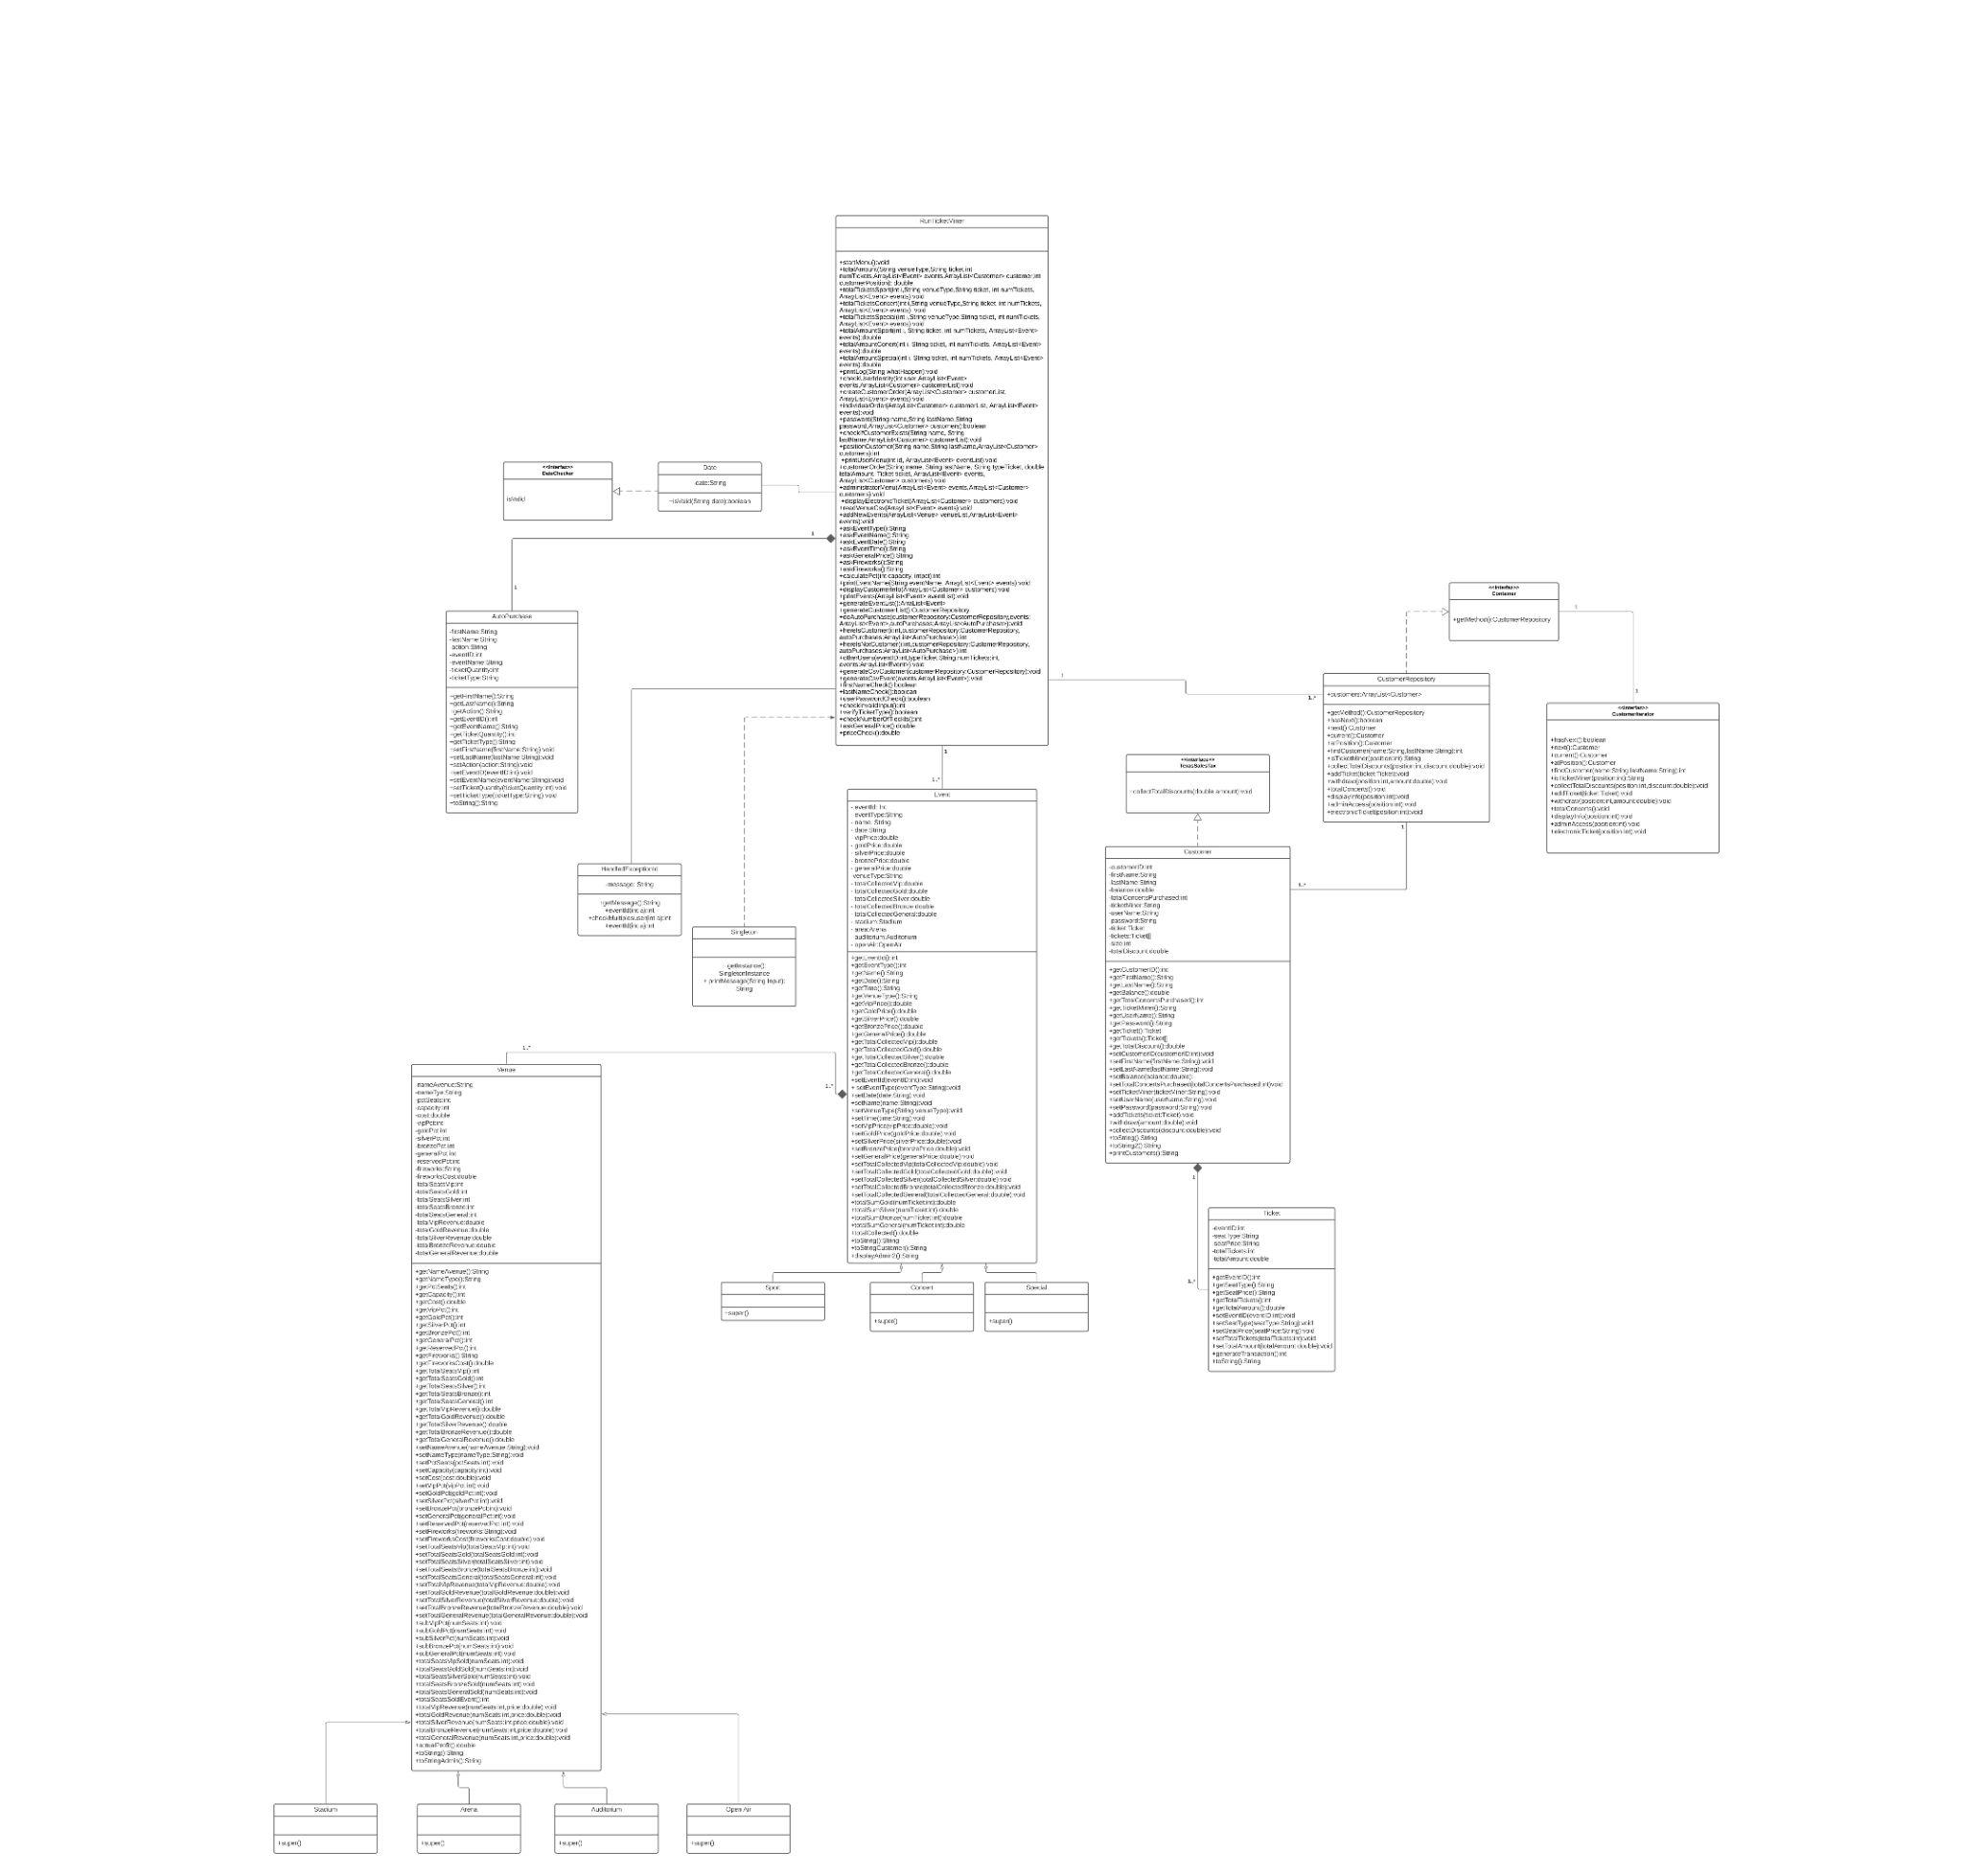
UML Class Diagram
→ 21 Classes
→ 2 are Abstract: Event & Venue
Event: Sport,Special,Concert.
Venue: Stadium,Auditorium,Arena and Open Air.
→ 4 Interfaces:
2 are connected to Customer Class.
1 is just for Taxes.
1 for Date Class.
Notes:
First, we start with the UML Class Diagram that we made for the TicketMiner. Since Power Point was not very helpful to us to present a good quality image, we have the option of presenting the Class Diagram through PDF. Either way I will be explaining quickly how we have the class diagram. The Class Diagram consists of a total of 21 classes and 3 interfaces. From these 21 classes, 2 of them are abstract which would be Event and Venue. These abstract classes (which we can call parents) have their own children. Event has Sport, Concert and Special as children while Venue has as children the 4 venues provided. Parents and children at the end are connected / related to the main class called RunTicketMiner, where we will be doing most of the tasks and requirements of the PA. Speaking about interfaces, 2 of them are connected to a Costumer and the third interface is simply for Taxes.

Slide 3
How did we use Object Oriented Programming?
Abstraction - Determined which classes to use as abstract.
Encapsulation - Information Hiding. The use of abstract classes and private variables.
Polymorphism - The use of Objects and Class methods to reach desired output.
Inheritance - Parent classes, Child classes(inherited parent attributes)

Slide 4
How did we use Design Patterns?
Iterator Design Pattern
The iterator pattern provides a way to access the elements of an aggregate object sequentially without exposing its underlying representation.
Why? → Easy to implement and readable.
→ Clean code
How it was used?
→ Implemented for Customer Class.
→ 2 interfaces called Container & CustomerIterator.
→ 1 additional class called CustomerRepository.
Singleton Design Pattern
The Singleton pattern provides a way to coordinate actions across a system with the use of one object. .
Why? → Easy to implement and readable.
→ Clean code
How it was used?
→ Implemented for RunTicketMiner.
→ RunTickeMiner Called Singleton Instance
→ StringRepo class called. Contained depot of different output strings.
Notes:
-During our discussions we were talking about implementing those Design Patterns that were appropriate according to our program and requirements. Some Design Pattern that was easy to implement and easy to read and understand when making code.
-Clean code because the client/context does not use a complex interface and the system is more flexible and reusable
-How we used it? CustomerRespository will be the principal instance we will use in RunTicketMiner to have access to the the customers information. In case where we want to get a specific method from the CustomerRepository to get some specific information from the customers we use the method provided in the Container interface.

Slide 5
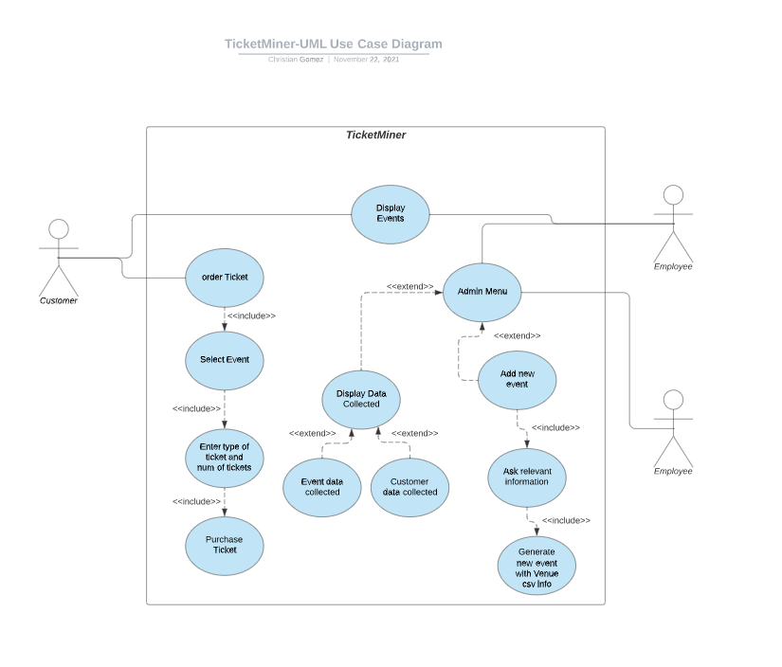
UML Use Case Diagram

Slide 6
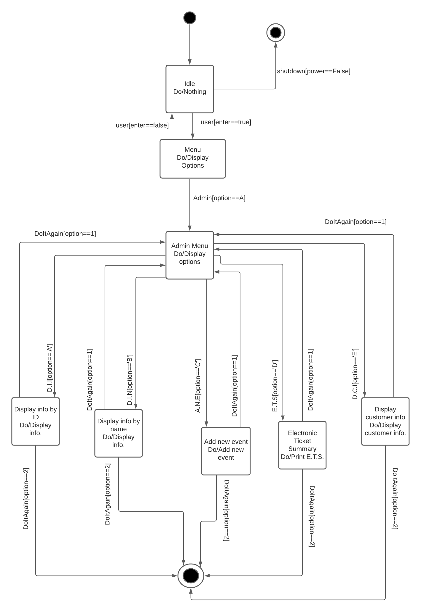
UML State Diagram
Notes:
For the UML State Diagram, we decided to do it on the options menu that is provided for the administrator. Our State Diagram consists of a total of 9 states, 1 initial states, and 2 final states. Why 2 final states? In this case we think that there are two ways to end the program and one would be through the power source being turned off or the admin deciding to end it.

Slide 7
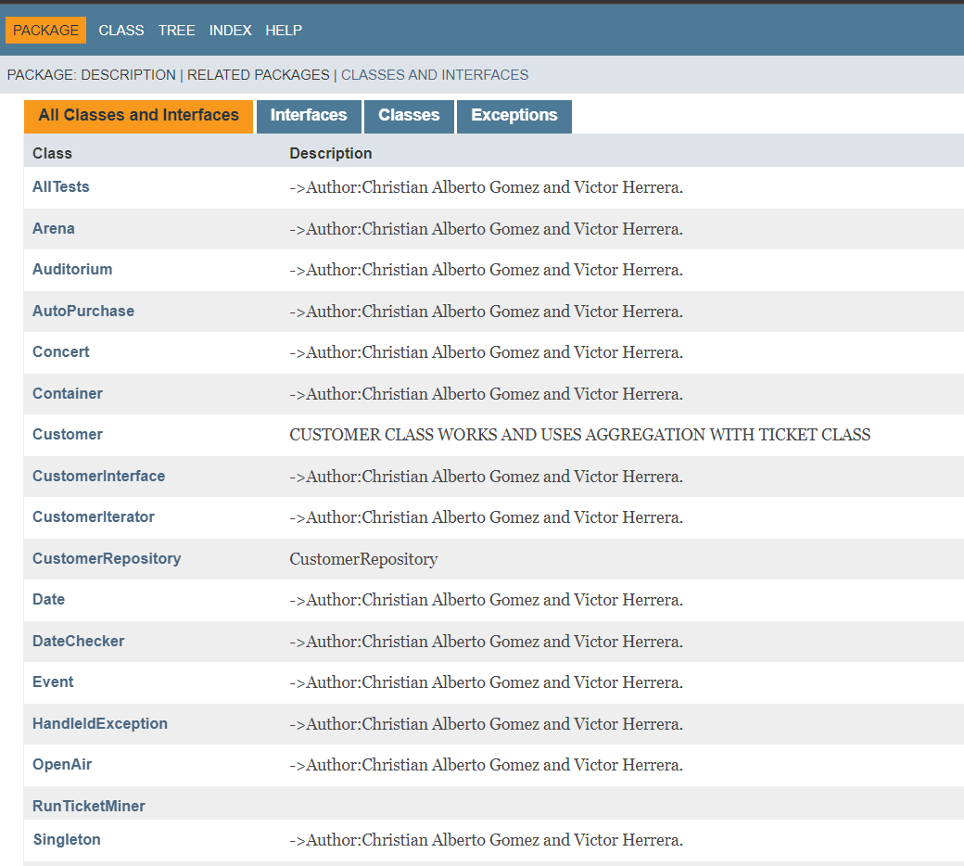
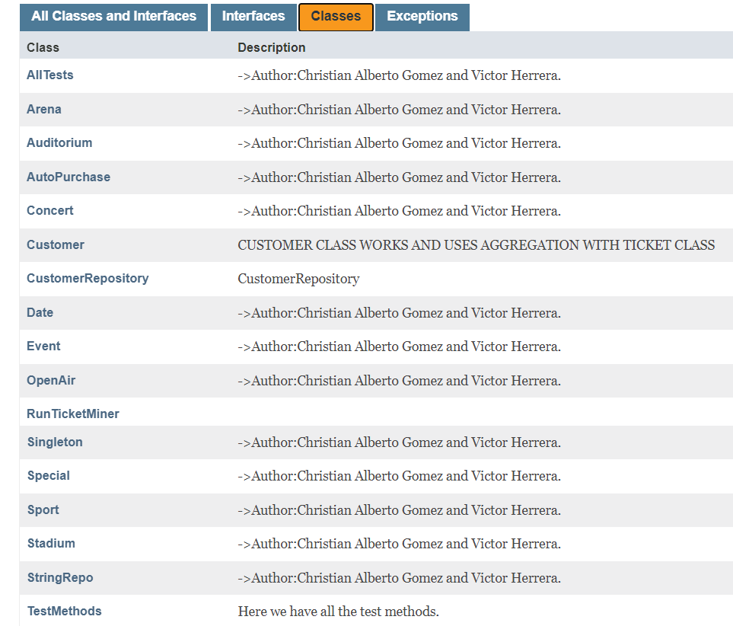
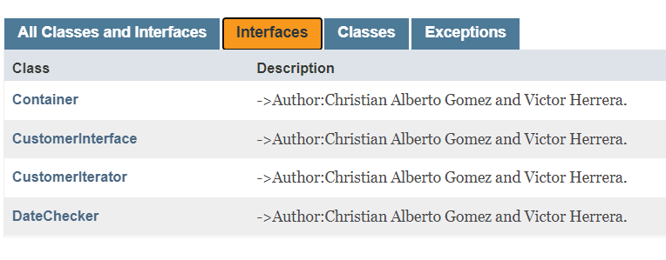
JavaDoc

Slide 8
Reflections
•What did we learn with this assignments?
•How did we grow as a student?
•How did we break up the problem to complete this task?
•How did you all grow in this course?
Notes:
How did we break up the problem to complete this task?
-We can say that having an action plan, constant communication and always asking for help in difficult moments was the best way to solve this problem. It should be noted that we were using a methodology which consisted of identifying the problem, looking for a solution to the problem, and finally planning multiple ways to solve it. Once we had this resolved we could proceed with the code.
How did we grow in this course?
-We can conclude that thanks to this semester we have been able to get new skills as programmers and improve those skills that we already possessed. Everything brings us to the point where not only the two of us, but the entire group from today can confirm that we feel more capable and with a better visualization of the future within this field.

Slide 9
References
https://www.w3schools.com/java/java_date.asp
McDonough, J. E. (2017). Singleton Design Pattern. In Object-Oriented Design with ABAP (pp. 137–145). Apress. https://doi.org/10.1007/978-1-4842-2838-8_11

